Slide 1
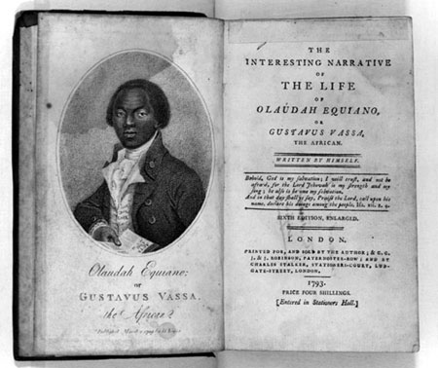
Exploring the life of Olaudah Equiano
LO: To understand who Equiano was and why he was so important.
BLP: Absorption Comm: Writing

Slide 2
Who was Equiano?
In pairs sort the first part of Equiano’s story into order.
Leave it on your desk as we will refer to it throughout the lesson.

Slide 3
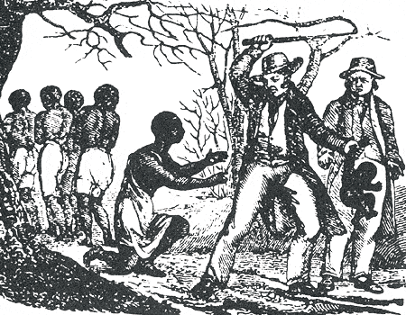
Who was Equiano?
Millions of Africans were transported across the Atlantic and sold into slavery but very few had the chance to describe their experience to the world.
One who did was an African named Olaudah Equiano.
He wrote an amazing autobiography that described his life's journey from freedom to slavery and back to freedom again.

Slide 4
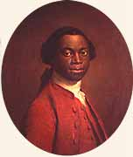
Childhood...
Olaudah Equiano was born into a wealthy West African family in 1745.
His family lived far from the sea, in an area now part of Nigeria.
When he was eleven, Equiano was captured by African slave traders.

Slide 5
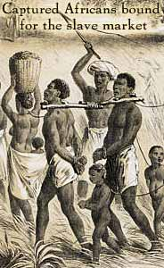
‘One day, when all our people were gone out to their works as usual, and only I and my dear sister were left to mind the house, two men and a woman got over our walls, and in a moment seized us both, and, without giving us time to cry out, or make resistance, they stopped our mouths, and ran off with us into the nearest wood. Here they tied our hands, and continued to carry us.’

Slide 6
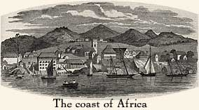
Equiano was sold several times and eventually ended up by the African coast.
What do you think happened to him next?

Slide 7
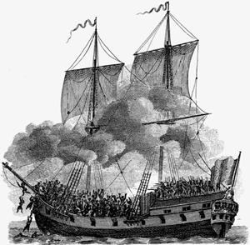
Equiano found himself on the Africa's Atlantic coast for the first time in his life. There he saw a slave ship anchored offshore.
He had no idea what lay ahead. No Africans had ever returned from the Americas to tell of their fate.

Slide 8
“When I looked around the ship and saw ... a multitude of black people, of every description, chained together, every one of their countenances expressing dejection and sorrow, I no longer doubted of my fate; and, quite overpowered with horror and anguish, I fell motionless on the deck, and fainted. . . I asked if we were not to be eaten by those white men with horrible looks, red faces and long hair?"
Task.
Describe what Equiano saw when he went onto the slave ship.
How do you think he felt and why?

Slide 9
Equiano was only 12 when he was transported on a slave ship.
How do you think he felt?
Write down as many words as you can to describe how he might have been feeling.

Slide 10
The slave auction...
‘On a signal given (as the beat of a drum), the buyers rush at once into the yard where the slaves are confined, and make choice... The noise with which this is attended, and the eagerness visible in the countenances of the buyers, serve not a little to increase the apprehension of terrified Africans... In this manner are relations and friends separated, most of them never to see each other again.’
Write down five words to describe the slave auction.

Slide 11
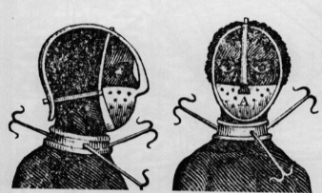
Equiano was taken north to a plantation in Virginia. There he was shocked to see the instruments used to control and punish slaves:
“A black woman slave was cruelly loaded with various kinds of iron machines; she had one on her head which locked her mouth so fast that she could barely speak, and could not eat or drink.”
Why do you think some
slaves were treated like
this ?

Slide 12
Equiano was soon sold again. His new owner was named Michael Henry Pascal, a lieutenant in the British navy.
Pascal gave him Equiano a new name:
Gustavus Vassa
Why do you think slave owners renamed their slaves?

Slide 13
Equiano refused to answer to this name at first. Pascal slapped him with each refusal, and soon he relented.
How is this similar to Kunta/Toby in Roots?
How is this different to Kunta/Toby in Roots?

Slide 14
Education in slavery...
Under Pascal, Equiano learned to be a sailor. He spent much time in England, where he managed to educate himself as well.
Based on what we know so far, what do you think of Pascal?
What do you think Equiano thinks about him?

Slide 15
“I began to consider myself as happily situated, for my master treated me always extremely well; and my attachment and gratitude to him were very great. I soon grew a stranger to terror of every kind, and was, in that respect at least almost an Englishman.”

Slide 16
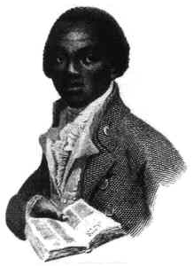
How does this image of Equiano back up what we know about him?

Slide 17
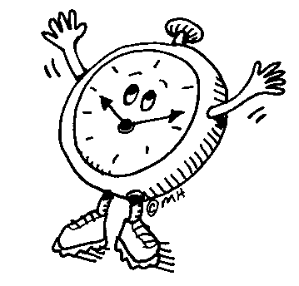
Write down everything you can remember about Equiano.
You have five minutes.

Slide 18
Now move around the room and get some more information from other people and add it to your notes.
You have five minutes.

Slide 19
Plenary
What do you think happened to Equiano next?
Discuss and write down your ideas.
https://www.youtube.com/watch?v=9_O3TWFFmoM
https://www.youtube.com/watch?v=9_O3TWFFmoM

