Slide 1
The Features of a Drainage Basin
Learning Outcome:
To Be able to describe the main features of a drainage basin.
ALL: Will be able to name 5 features of a drainage basin
MOST: Will be able to identify these features on a map and from photos
SOME: Will be able to explain how water travels through this system using key terms
BLP: Making Links
Skill: Listening

Slide 2
Starter
Line up in the corridor with the tallest in the middle, shortest on the outside, the girls on one side, boys on the other…
What shape do you make?
What would happen to water if it falls on one side of the tallest person?

Slide 3
Keywords for today:
Catchment
Watershed
Tributary
Confluence
Source
Mouth
Can you guess what any of these mean?
By the end of the lesson you will be able to define them!

Slide 4
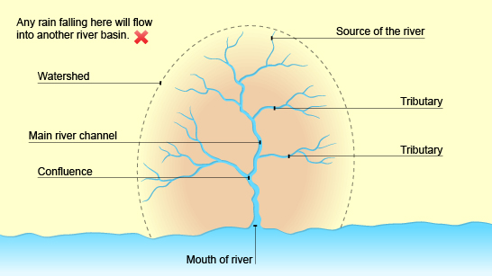
The Drainage Basin
VIDEO
TASK:
Make a sketch copy of this diagram into your books.
Use the Geography dictionaries to find out what the words mean
Below your diagram create a “glossary” which has all these words.
CLICK

Slide 5
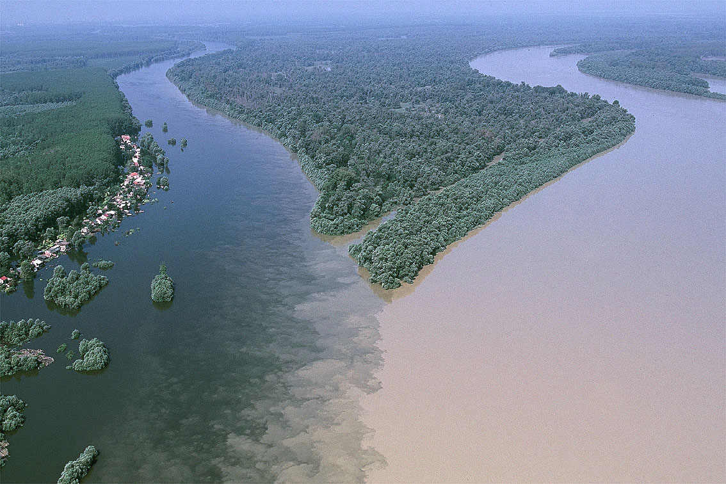
Which feature is this?

