Slide 1
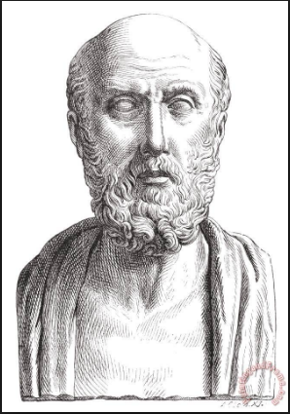
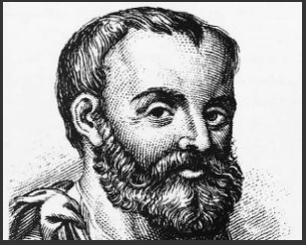
Hippocrates (c.460 BC-C.370 BC)
Galen (130 AD -200 AD)

