Slide 1
Newspaper Reporting
What is the story?

Slide 2
Lesson Objectives
All should be able to write in the style of a newspaper report.
Most should be able to write creatively, at the same time showing what you know.
All should be using key geographical terms (keywords) in their articles.

Slide 3
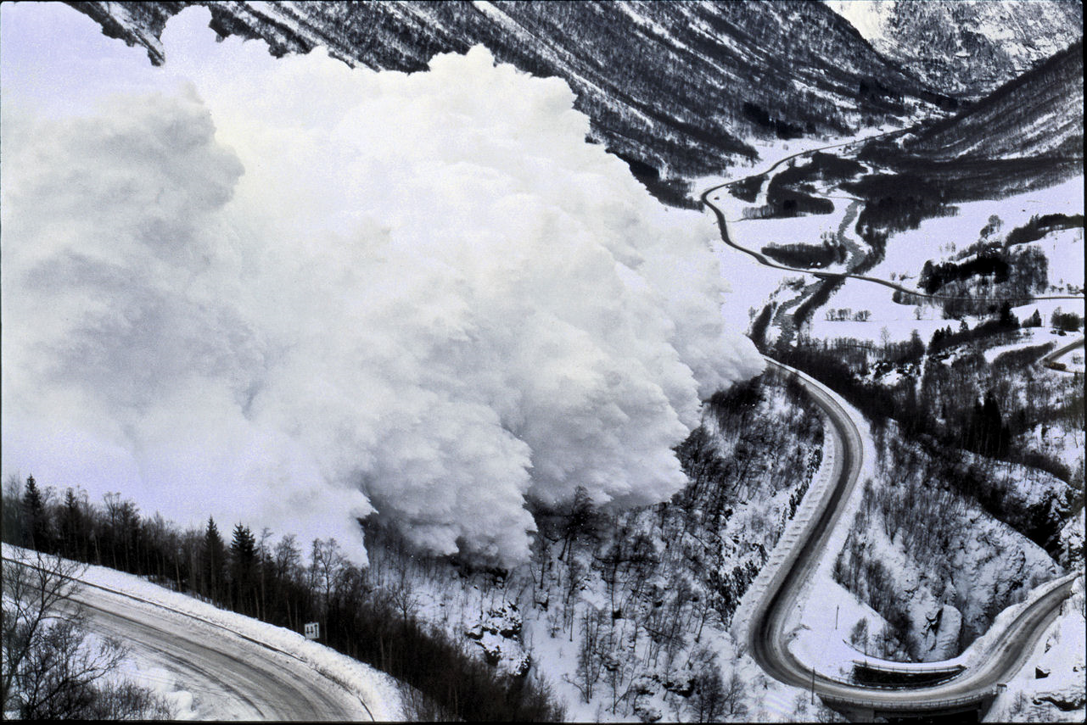
What is the story?
Look at the following picture:
What can you see?
What geography story could be there?
Who may have been affected?
What processes may have been involved?
What should be done about it?
What opinions may people have?

Slide 4
You will be given a set of photos.
Your task is to create a story around this photo, it has to be completely made up, but needs to have REAL geography in it!
You could create a character, or a place, or you could use real ones.
You must use a newspaper format:
Headline
Columns
Quotes
Pictures (you can draw these)
Homework:
Finish your story over the holiday, make sure it is neat, tidy, and colourful. Try to use as many keywords as you can!
Due: Friday 9th January 2015

Slide 5
Peer Assessment Grid
Level | Content | Skills and Keywords
3 | 3 Geography articles. Describing the images (what do they see) Link to geography on one story | Labelling photos Using 5 keywords (Rain, tsunami, forest fire, flood, poverty, tourism etc…)
4 | 5 Geography articles Story is based on a geography Knowledge of Human/Physical/environmental geography | Photo Annotated with keywords Using 10 keywords, and not missing many opportunities
5 | 6 Geography articles, with extra information (i.e. TV guide, adverts, sports) Good understanding of at least one geographical process (i.e. heavy rain causing flooding) An attempt to link geography ideas together i.e. flooding leading to loss of income etc. | Attempts to explain. Presentation good. Use of keywords at every opportunity. Addition of map information/real places and locations well described.

