Slide 1
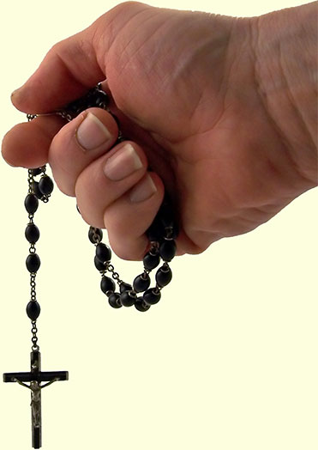
Prayer Homework
Prayer Homework
Answer the following questions in full sentences:
Find Jesus’ prayer in Gethsemane in Mark 14:32-36. Did God answer the prayer? Try to give two points of view. ______________________________________________________________________________________________________________________________________________________________________________________________________________________________________________________________________________________________________________________________________________________________________________________________________________________________________________________________________________________
How do Orthodox Christians use icons to worship God in their homes? _________________________________________________________________________________________________________________________________________________________________________________________________________________________________________________________________________________________________________________________________________
How do Catholics use rosary to pray? _____________________________________________________________________________________________________________________________________________________________________________________________________________________________________________________________________________________________________________________________________________________________________________________________________________________________
Answer the following questions in full sentences:
Find Jesus’ prayer in Gethsemane in Mark 14:32-36. Did God answer the prayer? Try to give two points of view. ______________________________________________________________________________________________________________________________________________________________________________________________________________________________________________________________________________________________________________________________________________________________________________________________________________________________________________________________________________________
How do Orthodox Christians use icons to worship God in their homes? _________________________________________________________________________________________________________________________________________________________________________________________________________________________________________________________________________________________________________________________________________
How do Catholics use rosary to pray? _____________________________________________________________________________________________________________________________________________________________________________________________________________________________________________________________________________________________________________________________________________________________________________________________________________________________

