Slide 1
Tropical Rainforests
Wednesday, 05 October 2016
Learning Objectives:
1. To be able to describe the physical characteristics of the TRF.
2. To appreciate the interdependence of the components of the TRF.
Notes:
Biodiversity is so high due to the high amount of sunlight and water available allowing for excellent growing conditions for plants (photosynthesis) which then provide a vast food supply for the rest of the food chain.

Slide 2
Key ideas about TRF.
Found in a broad band through the tropics, close to the Equator.
Characterised by high rainfall (over 2,000mm per year) and high temperatures (average 27°C).
Soils are infertile due to leaching.
Have enormous biodiversity – home to half the world’s species.
Animals and plants have adapted and are part of this fragile ecosystem which is easily affected by small changes.

Slide 3
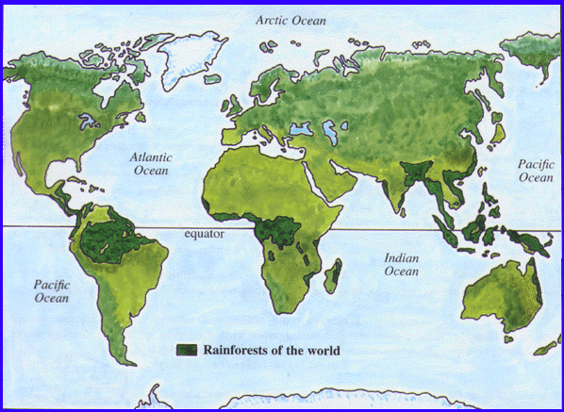
LOCATION OF RAINFORESTS
You need to add the correct rainforest name to the red dots above.
Amazon Rainforest, Congo Rainforest, Borneo Rainforest, Madagascar Rainforest, Queensland’s Tropical Rainforests,
Ecuador’s Cloud forest, Monteverde Rainforest,, Sinharajin Forest, Sumatra’s Rainforest

Slide 4
What is the climate like in the Rainforest?

Slide 5
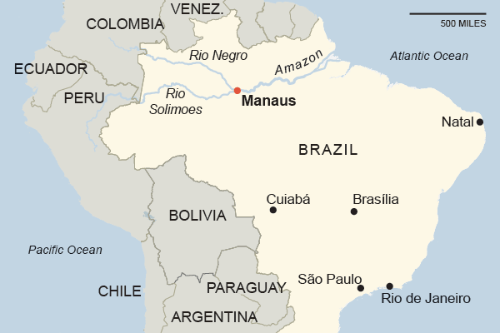
Location of Manaus

Slide 6
Drawing a climate graph…
Month | Temp © | Rainfall (mm)
Jan | 31 | 249
Feb | 31 | 231
Mar | 31 | 262
April | 31 | 221
May | 31 | 170
Jun | 31 | 84
July | 32 | 58
Aug | 33 | 38
Sept | 33 | 46
Oct | 33 | 107
Nov | 33 | 142
Dec | 32 | 203

Slide 7
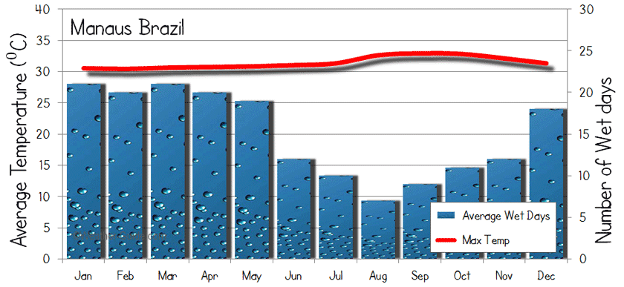
Climate graph for Manaus

Slide 8
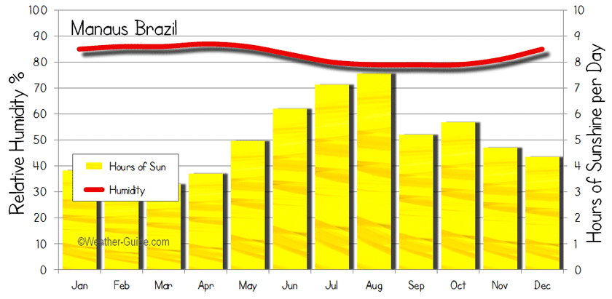

Slide 9
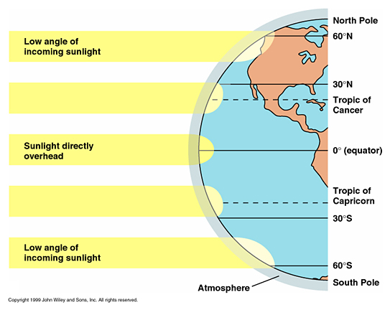
Why is the temperature always high?

Slide 10
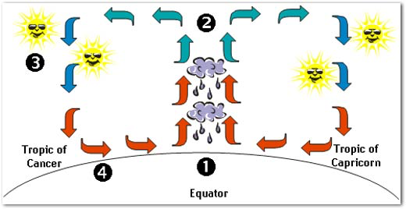
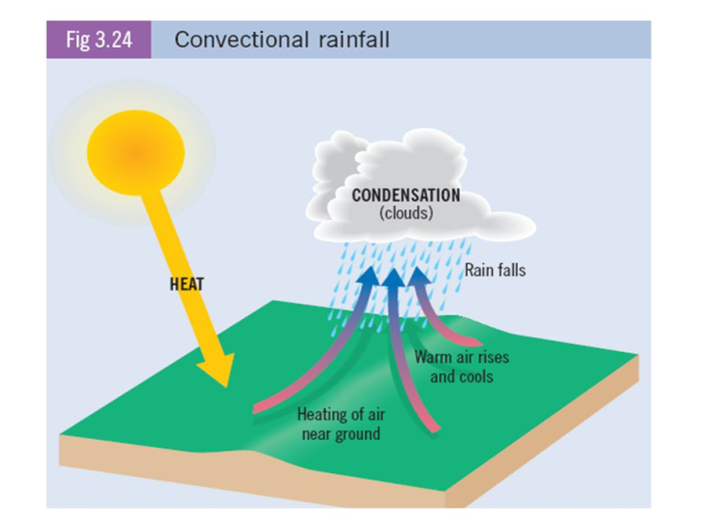
Why is the rainfall always so high?

Slide 11
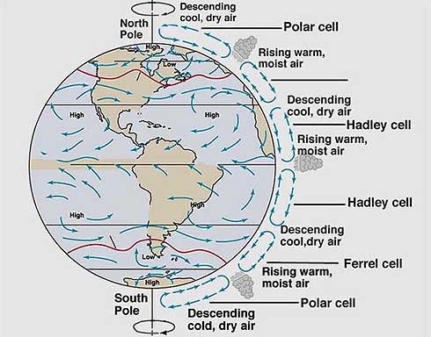
EXAM ALERT!! You Will Need To Know This.
Lets go outside to get it into our heads!!

Slide 12
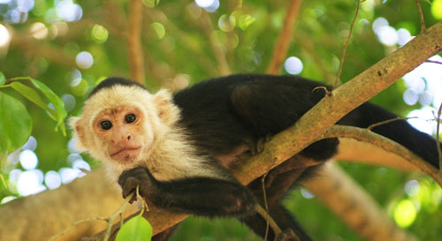
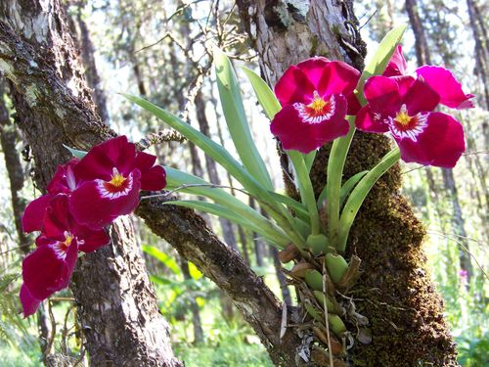
Homework
Task: Design a ‘new’ plant or animal that would be able to survive in the rainforest. Label and explain the adaptations.
Your partner will have to work out which layer the plant or animal belongs to and will peer mark your work..
No flowers to save energy
Green to trap light

Slide 13
Lesson 2 – The Structure of the TRF
Watch the following video:
https://www.youtube.com/watch?v=JEsV5rqbVNQ
Make notes on the layers of the TRF – there are 4 key layers.

Slide 14
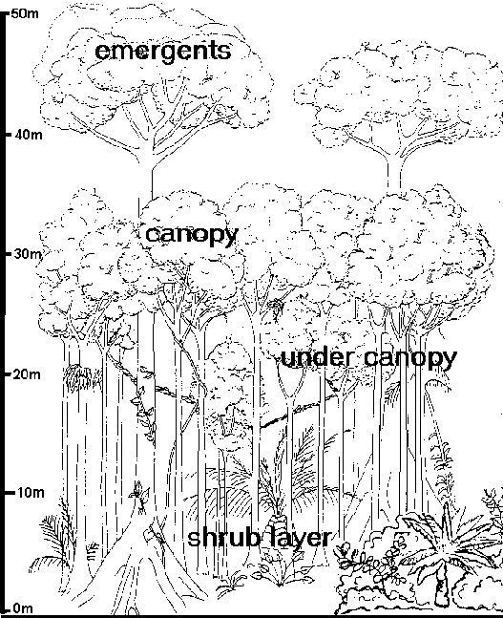
Your task:
Draw a cross section of the TRF to show the layers, and add the nutrient cycle to one side.

